Slide 1

Exploratory Data Analysis
Cross-Selling Recommendation
30/07/2024
Maria Pinto

Slide 2
Agenda
Executive Summary
Problem Statement
Approach
Data main Features
Descriptive Statistics
EDA
Recommendations

Slide 3
Executive Summary
Objective
XYZ Credit Union, a leading financial institution in Latin America, excels in selling individual banking products but faces challenges in cross-selling additional products to existing customers. The credit union partnered with ABC Analytics to develop data-driven strategies to enhance cross-selling efforts, thereby increasing product acquisition per customer.

Slide 4
Expected Outcomes
By implementing these recommendations, XYZ Credit Union can expect to achieve the following outcomes:
Increased Product Acquisition: Higher number of products per customer, leading to greater revenue per customer.
Improved Customer Satisfaction: Personalized and relevant product offerings will enhance the overall customer experience.
Higher Retention Rates: Engaged customers with multiple products are more likely to remain loyal to the credit union.
Revenue Growth: A successful cross-selling strategy will contribute significantly to the credit union's overall revenue growth.

Slide 5

Problem Statement
XYZ Credit Union in Latin America is performing well in selling individual banking products but struggles with cross-selling. Existing customers typically buy only one problem, limiting the bank’s potential revenue from its customer base. The Goal is to analyze the data to provide insight and recommendations to prove cross-selling rates.

Slide 6
Approach
Goals:
Understand customer purchase behavior.
Identify potential customer segments for cross-selling.
Provide actionable recommendations to enhance cross-selling efforts.
Data Cleaning:
Remove duplicates
Handle missing values(imputation, removal)
Correct any data entry errors
Data transformation:
Convert categorical variables into numeric and vice versa
Standardize and normalize numerical features.
Create new features (when necessary)

Slide 7
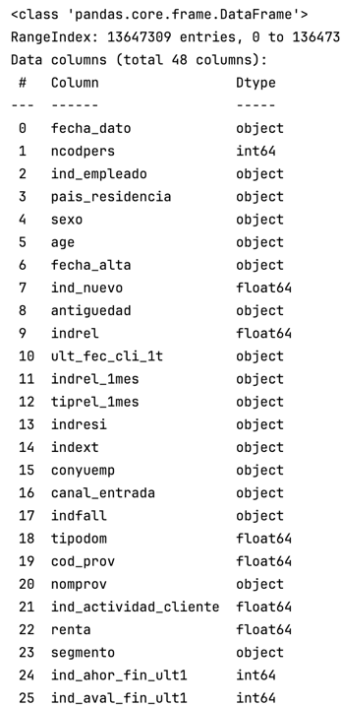
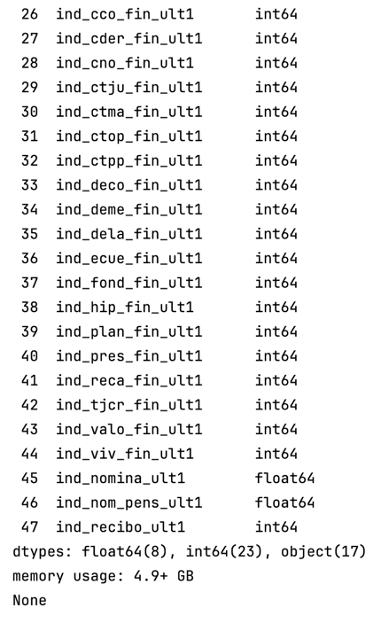
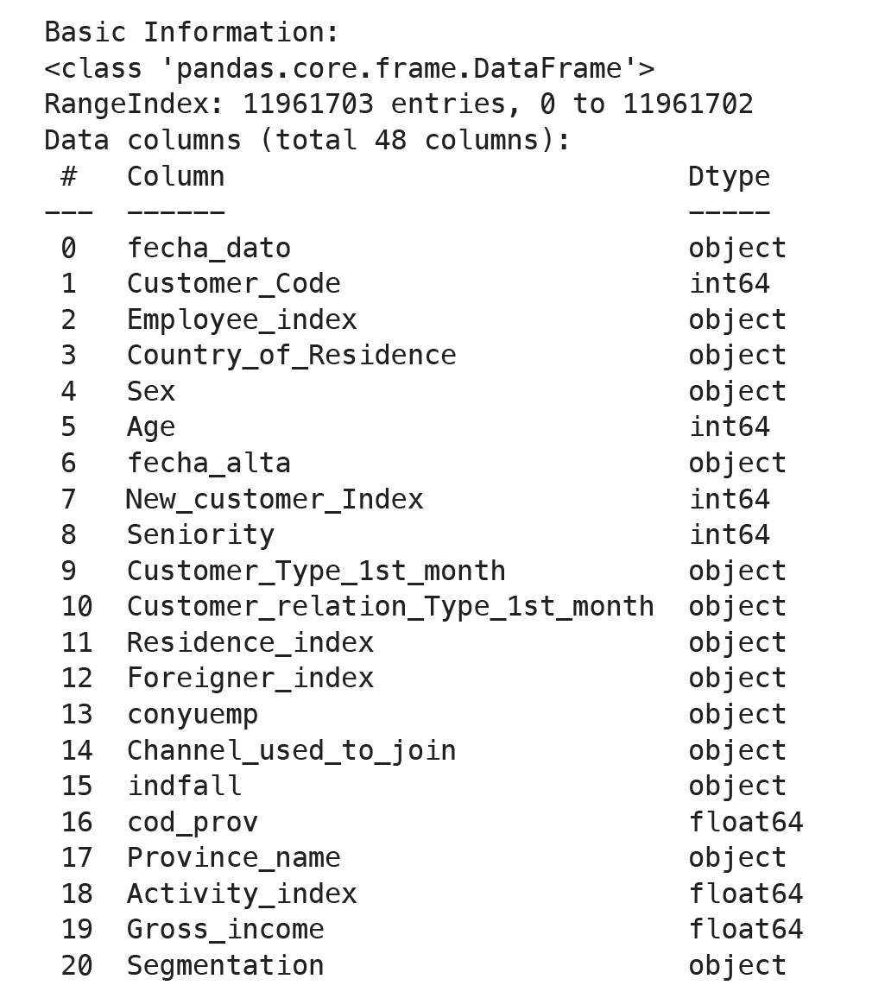
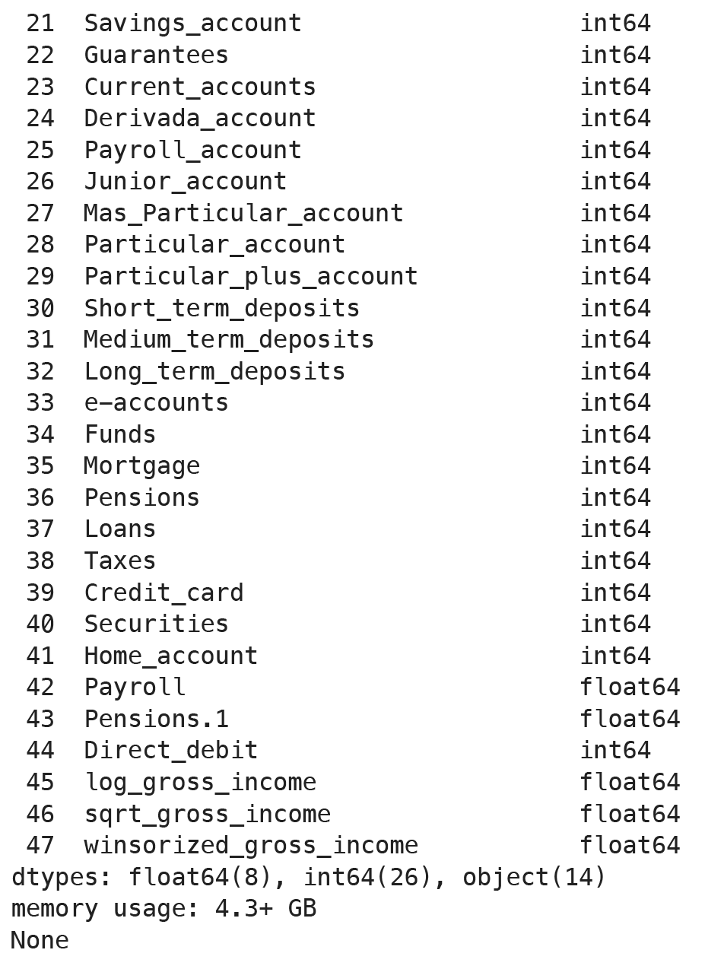
Data main features
Data cleaning
and
Data Transformation

Slide 8
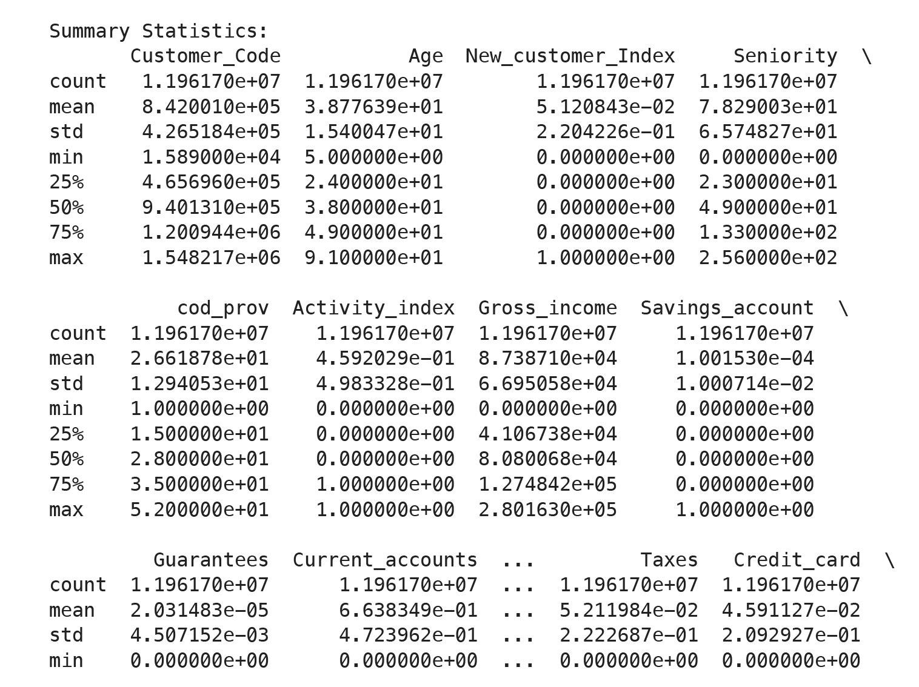
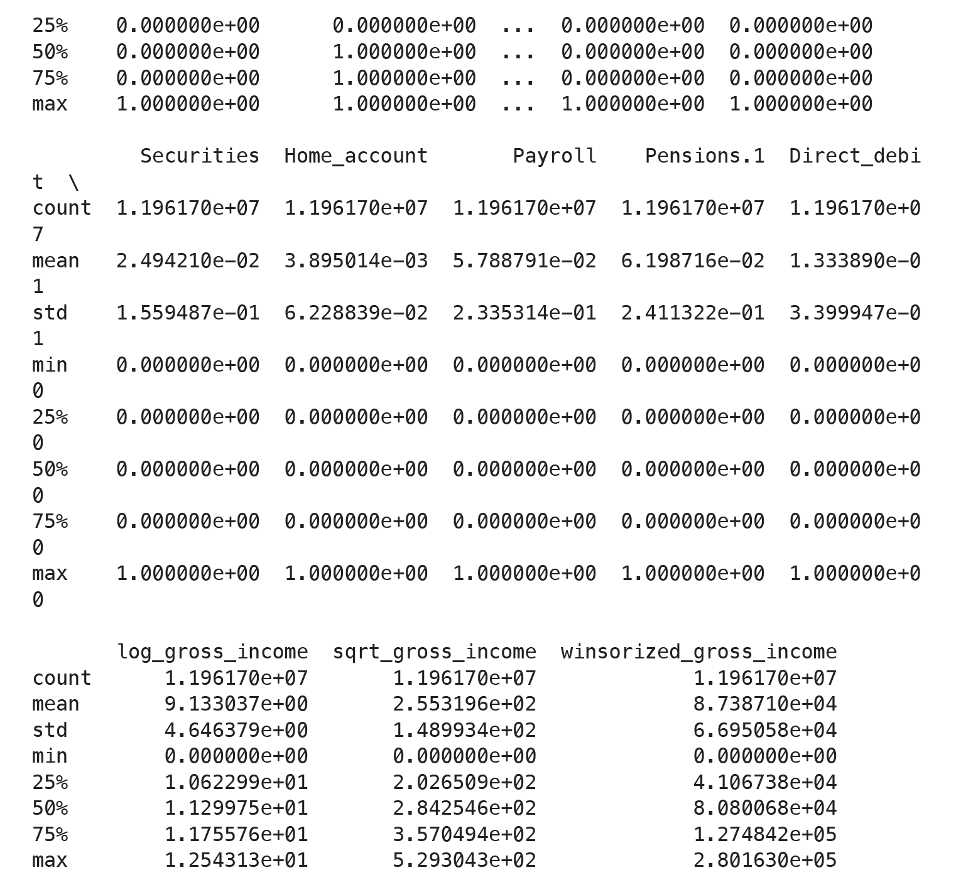
Descriptive Statistics

Slide 9
Visualization

Slide 10
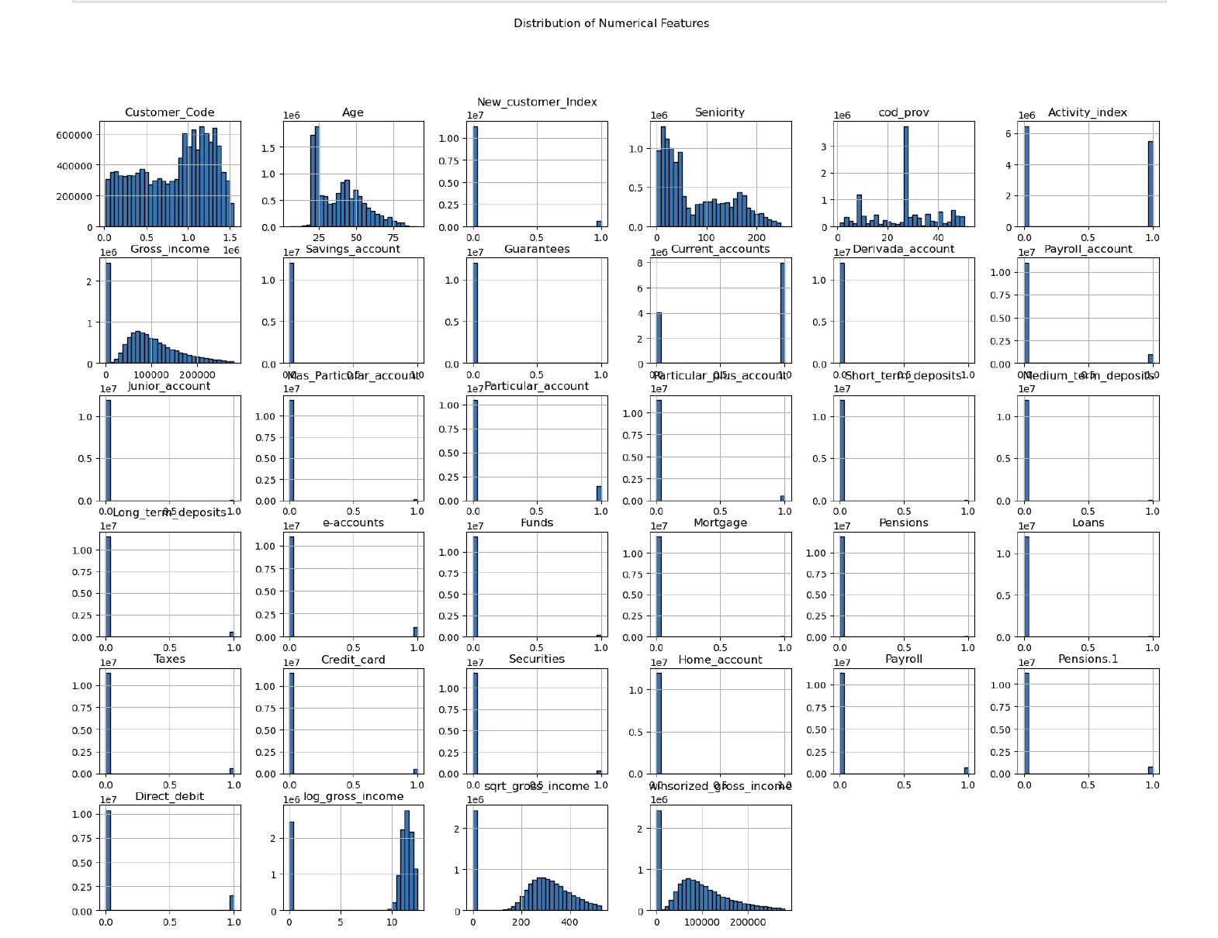
Univariate Analysis
The analysis reveals key insights about XYZ Credit Union's customer demographics and product adoption. The typical customer is around 40 years old, with a right-skewed gross income distribution indicating most earn below 100,000 units. Savings and payroll accounts are widely adopted, while products like junior accounts and e-accounts have lower adoption, suggesting opportunities for increased marketing. A significant portion of customers is active, and there is a mix of new and long-term customers based on the seniority distribution.
Investment products, such as loans, funds, and securities, have lower distribution, highlighting potential growth areas. Direct debit is popular, offering cross-selling opportunities for related products like credit cards and loans. Focusing on high-value customers, developing age-specific products, and leveraging widely adopted accounts for cross-selling can enhance product offerings and increase customer engagement and satisfaction.

Slide 11
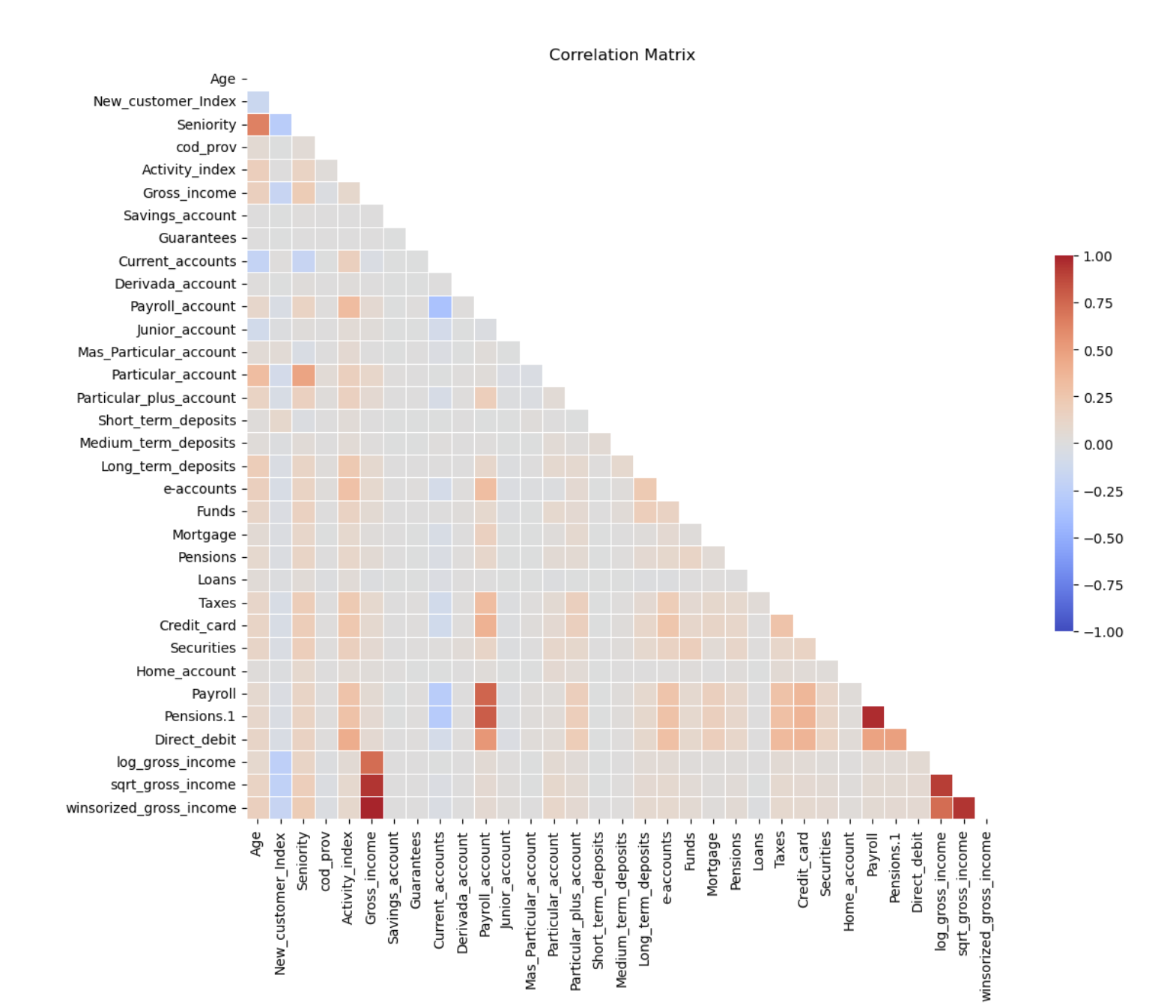
Correlation Analysis:
Savings and Payroll Accounts:
Savings Account and Gross Income: There is a positive correlation between having a savings account and gross income, suggesting that higher-income customers are more likely to have savings accounts.
Payroll Account and Gross Income: Similarly, there is a positive correlation between payroll accounts and gross income, indicating that higher-income customers also tend to have payroll accounts.
Activity Index:
Activity Index and Seniority: There is a negative correlation between activity index and seniority, suggesting that more senior customers (longer duration with the bank) may be less active. This insight could help in targeting senior customers with re-engagement strategies.

Slide 12
Multiple Account Types:
Current Accounts and Payroll Accounts: There is a positive correlation between current accounts and payroll accounts. Customers with payroll accounts often also have current accounts, indicating an opportunity to cross-sell related products.
Multiple Savings Products: There are positive correlations among different savings products (e.g., savings account, short-term deposits, long-term deposits), suggesting that customers with one type of savings product are likely to have or be interested in others.
Loans and Mortgages:
Loans and Mortgages: There is a positive correlation between loans and mortgages, indicating that customers who take out loans are also likely to have mortgages. This suggests an opportunity for bundled loan and mortgage products.
Investment Products:
Funds and Securities: There is a positive correlation between funds and securities accounts, suggesting that customers who invest in funds are also likely to invest in securities. This provides an opportunity to cross-sell these investment products.

Slide 13
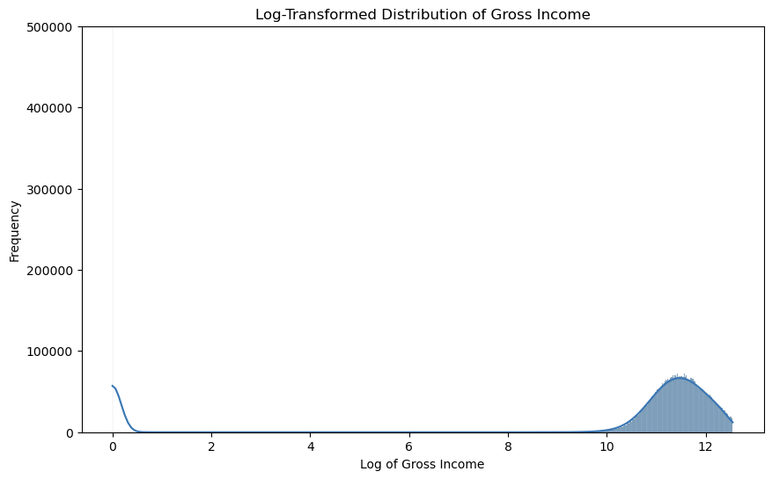
The graph shows a significant skew towards higher income levels after transformation, indicating that most customers fall within a high-income bracket. The peak around log values 10 to 12 suggests that most customers have substantial gross incomes. The log transformation helps in normalizing the data, reducing the impact of outliers and providing a clearer view of income distribution patterns. This insight can be leveraged to design premium financial products and services tailored for high-income customers, enhancing cross-selling opportunities and customer engagement for XYZ Credit Union.
The log-transformed distribution of gross income

Slide 14
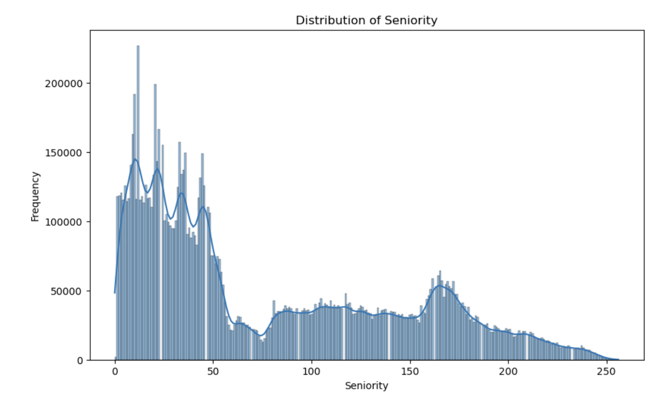
Histogram for the Seniority column
Key Observations:
Peak in Early Tenure:
The distribution shows a significant peak in the early months of seniority (0-50 months). This indicates that a large number of customers have been with the credit union for a relatively short period.
The highest frequency is observed around the first few months, suggesting many customers are recent joiners.
Decline and Subsequent Stability:
After the initial peak, there is a noticeable decline in the number of customers as seniority increases. This decline stabilizes after around 50 months, indicating fewer customers have stayed beyond this period.
There is a more stable distribution of customers with medium-term seniority (50-150 months), though the numbers are lower compared to the early tenure.
Another Increase in Long-Term Tenure:
There is a slight increase in the number of customers with long-term seniority (150-250 months), suggesting a segment of highly loyal customers who have been with the credit union for many years.
This increase may indicate the presence of a core group of long-term, committed customers.

Slide 15

EDA

Slide 16
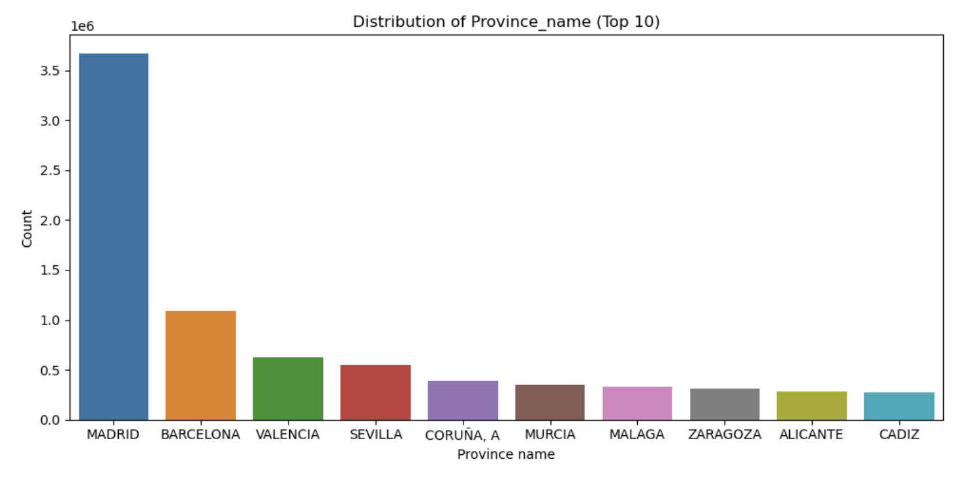
Geographical Distribution:
Province Distribution: The highest concentration of customers is in Madrid, followed by Barcelona, Valencia, and Sevilla. This indicates a significant market presence in these provinces and suggests a high potential for targeted cross-selling campaigns in these areas.

Slide 17
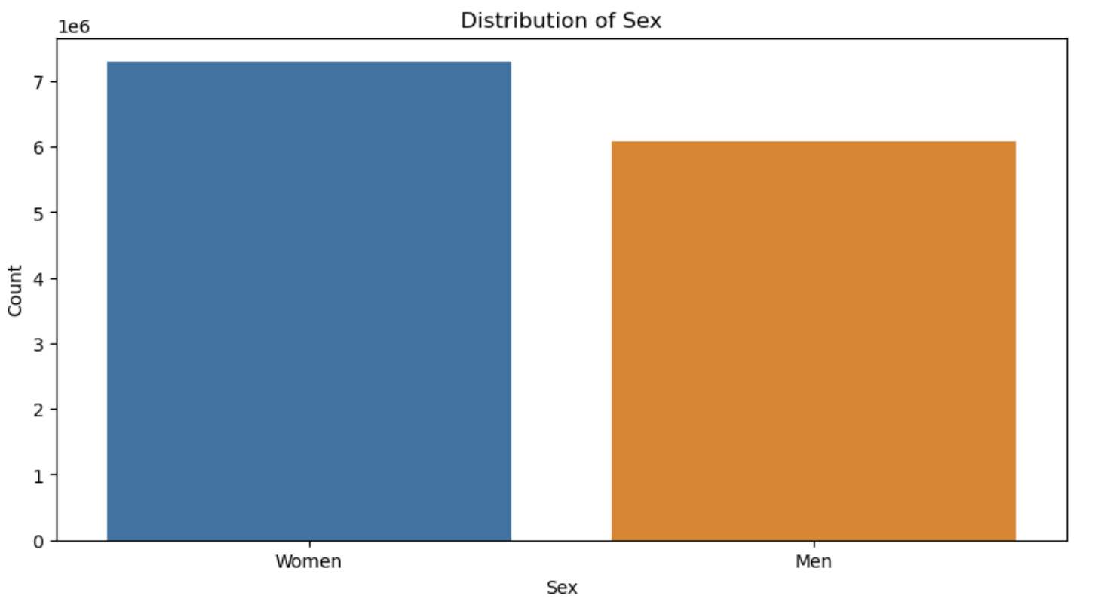
The distribution of customers by sex, revealing that women constitute a slightly larger proportion of the customer base than men.
Financial products and services that cater to the needs and preferences of women can be emphasized, and marketing campaigns can be tailored to appeal more effectively to female customers. Similarly, understanding the preferences of male customers can help design targeted promotions to engage this significant segment better.

Slide 18
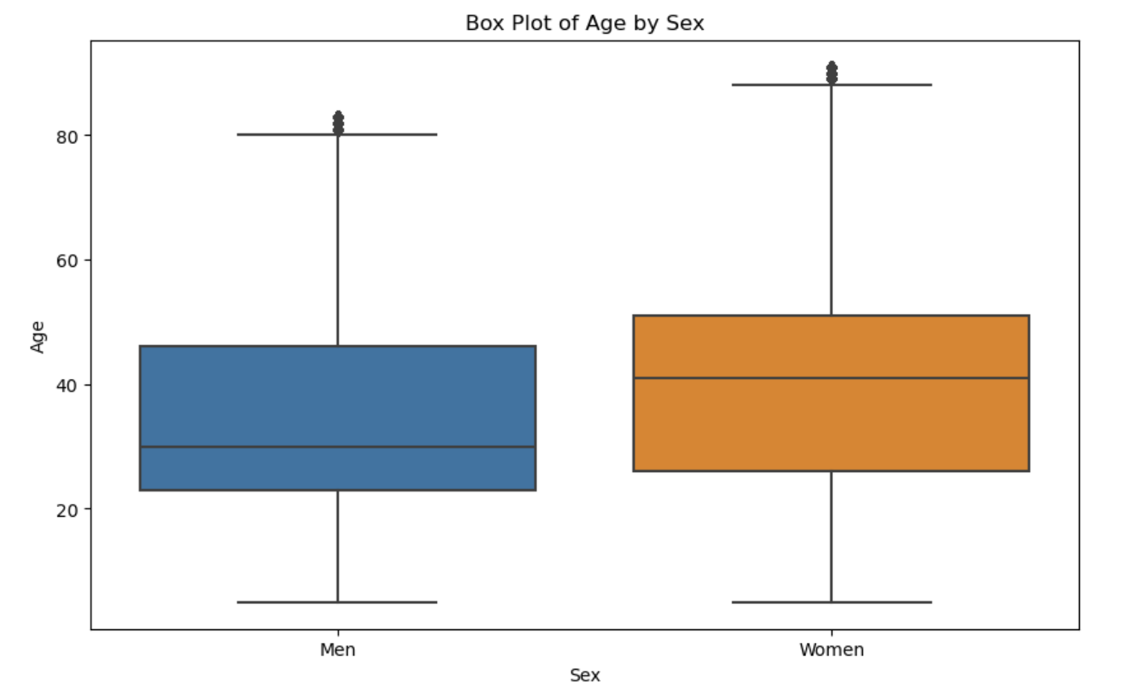
The box plot of age by sex provides a visual summary of the distribution of ages for men and women in the dataset.
The median age for both men and women is similar, falling around the mid-40s. This indicates that the typical age of customers is around this range for both genders.
The IQR (Interquartile Range) for men is slightly narrower than that for women. This suggests that the ages of men are more tightly clustered around the median compared to women, who have a wider age distribution.

Slide 19
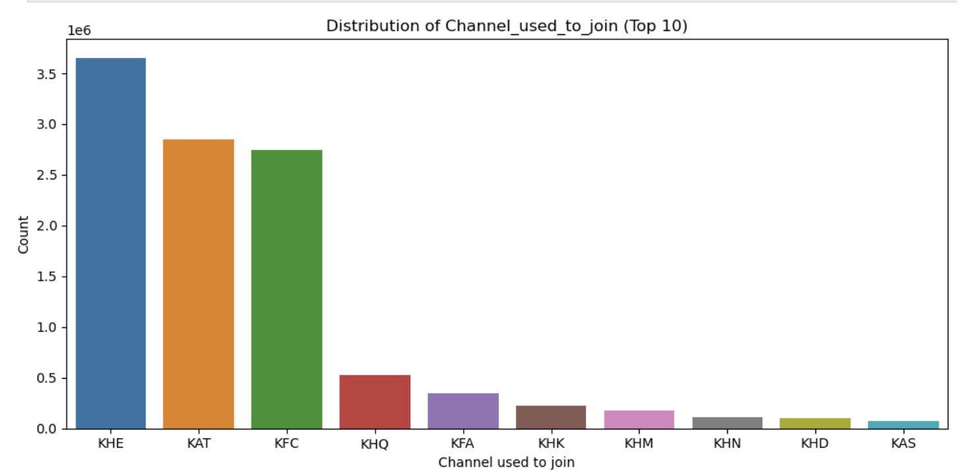
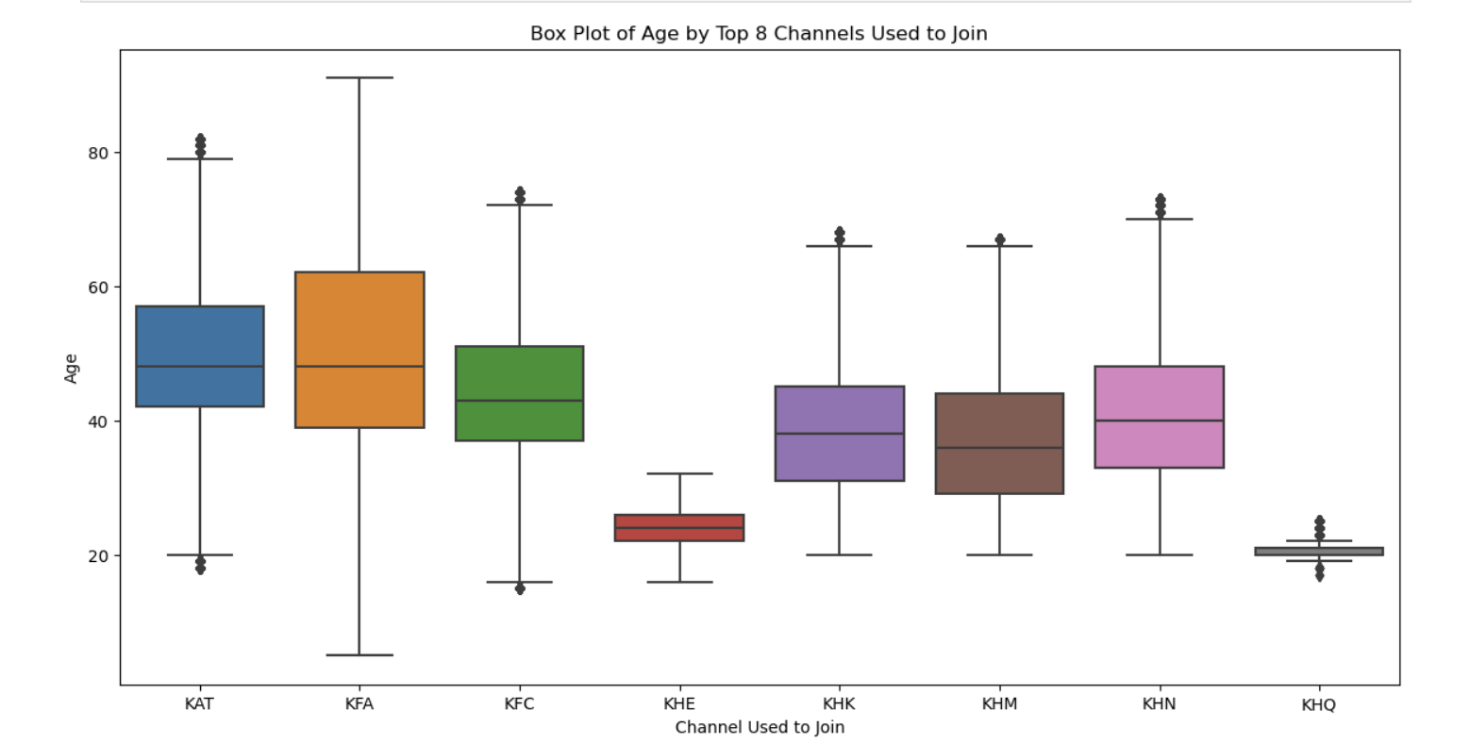
Channel Effectiveness:
Channel Usage: Channels KHE, KAT, and KFC are the most utilized for joining the credit union. Understanding the effectiveness of these channels can help tailor cross-selling strategies for customers based on their preferred channels of engagement.
Age Distribution by Channel: Customers joining through different channels exhibit varying age distributions. For instance, channels KAT and KFC have a wider age range, while KHQ tends to attract younger customers.

Slide 20
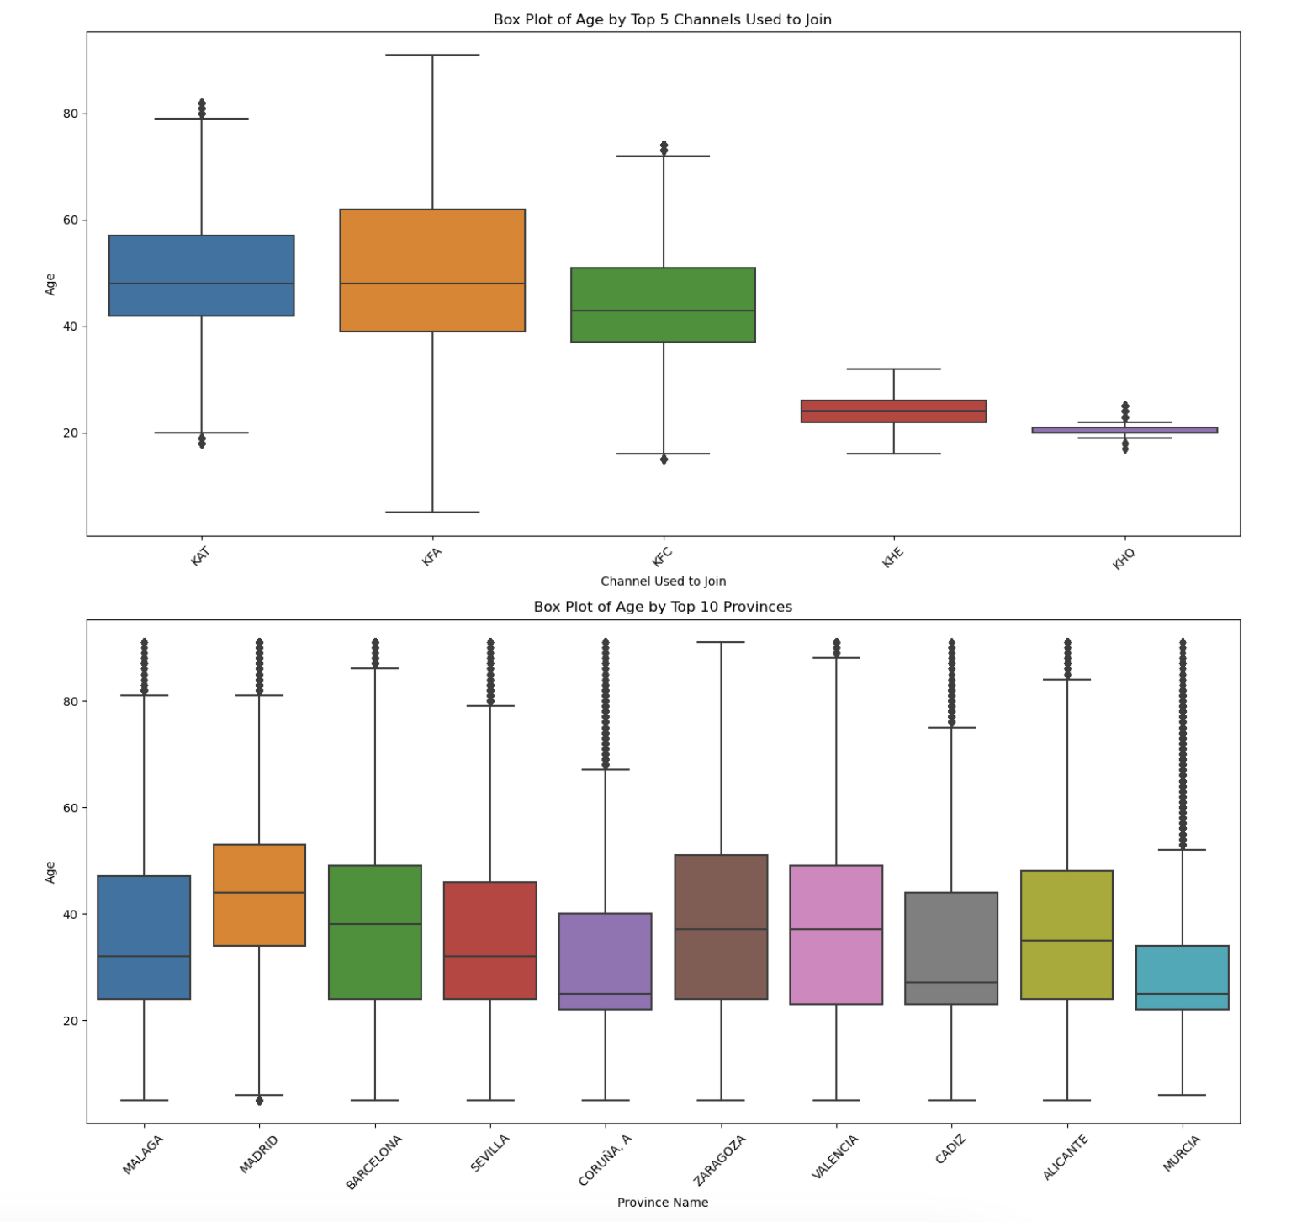
Box Plot of Age by Top 5 Channels Used to Join
KAT, KFA, KFC: These channels attract a wide age range of customers, with the median age around the mid-40s.
KHE and KHQ: These channels have a younger customer base with lower median ages and a narrower age range.
Box Plot of Age by Top 10 Provinces
Madrid, Barcelona, and Valencia: These provinces show a wide age range of customers with a median age around the mid-40s.
Other provinces: Generally follow a similar pattern with a broad age distribution, although there are some differences in the median ages and interquartile ranges.

Slide 21
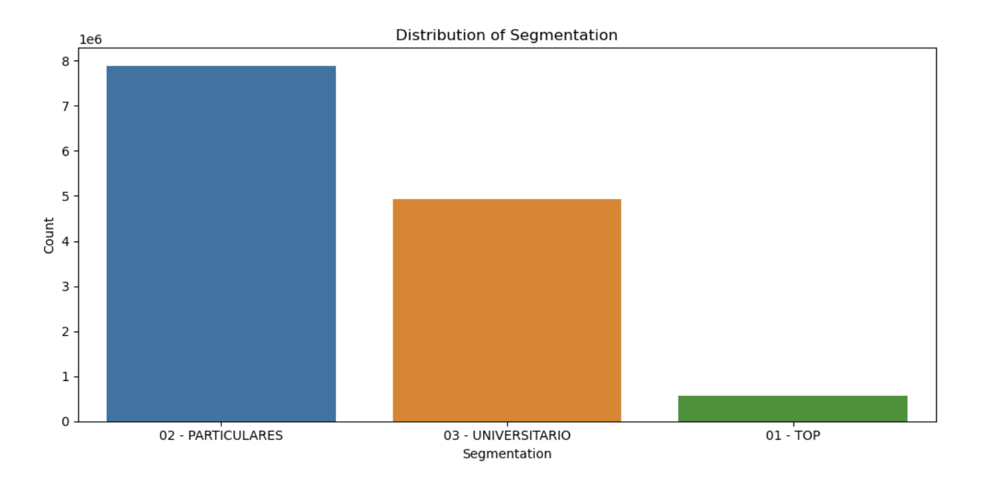
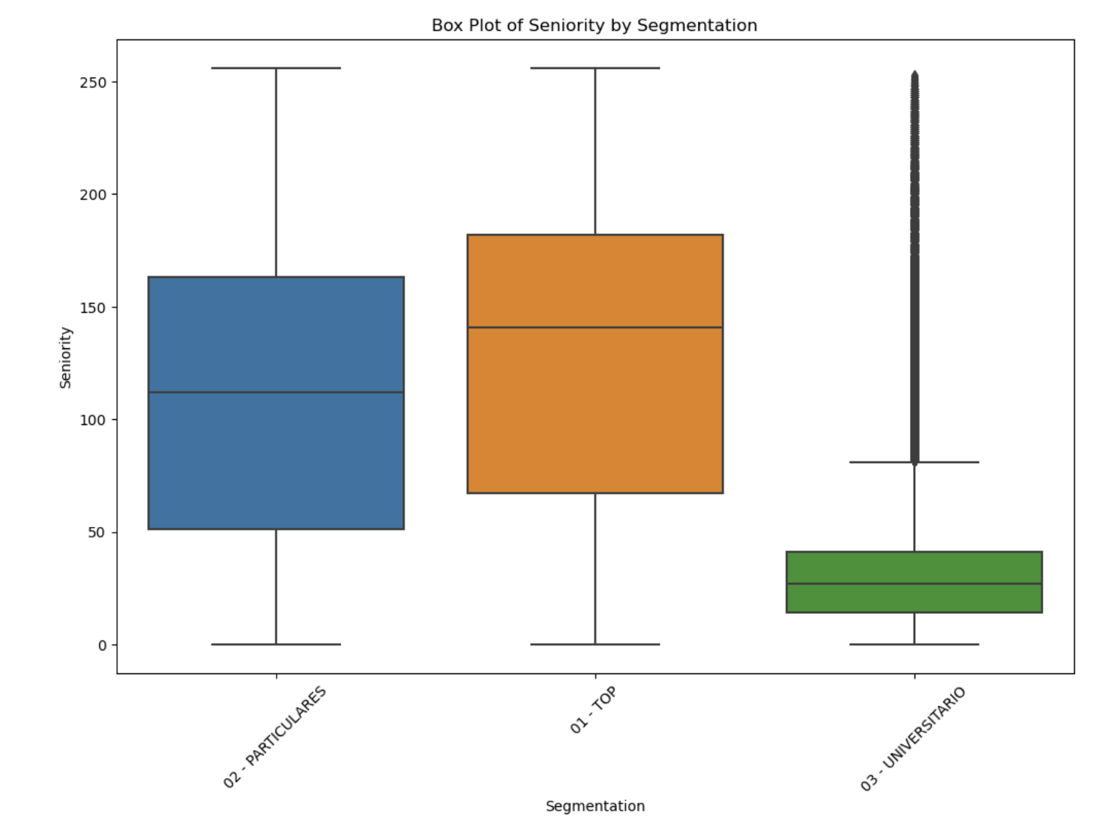
Customer Segmentation:
Age and Seniority by Segmentation: The segmentation into ‘Particulares,’ ‘Top,’ and ‘Universitario’ shows distinct age and seniority patterns. The ‘Top’ segment is characterized by older and more senior customers, whereas the ‘Universitario’ segment consists of younger customers with shorter tenures.
Mean Age by Segmentation and Channel: There is a noticeable age difference across segments and channels, with the ‘Top’ segment generally being older regardless of the channel used to join

Slide 22
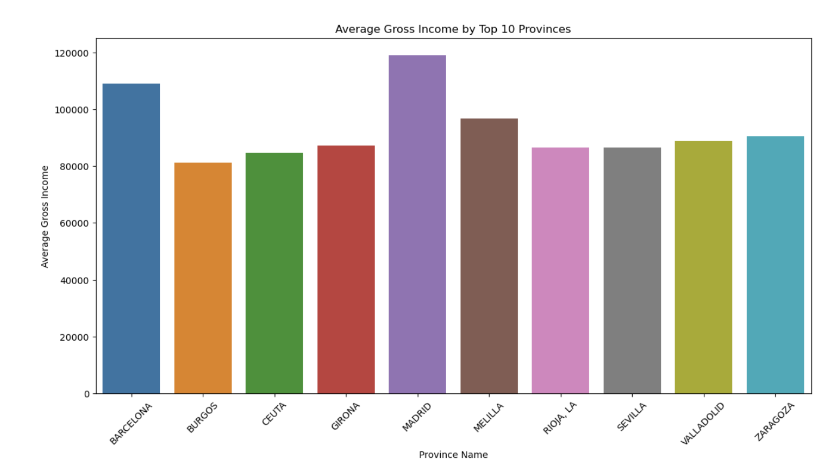
Income Insights:
Average Gross Income: Customers from Madrid and Barcelona exhibit higher average gross incomes compared to other provinces. This suggests a higher potential for cross-selling premium products in these regions.

Slide 23
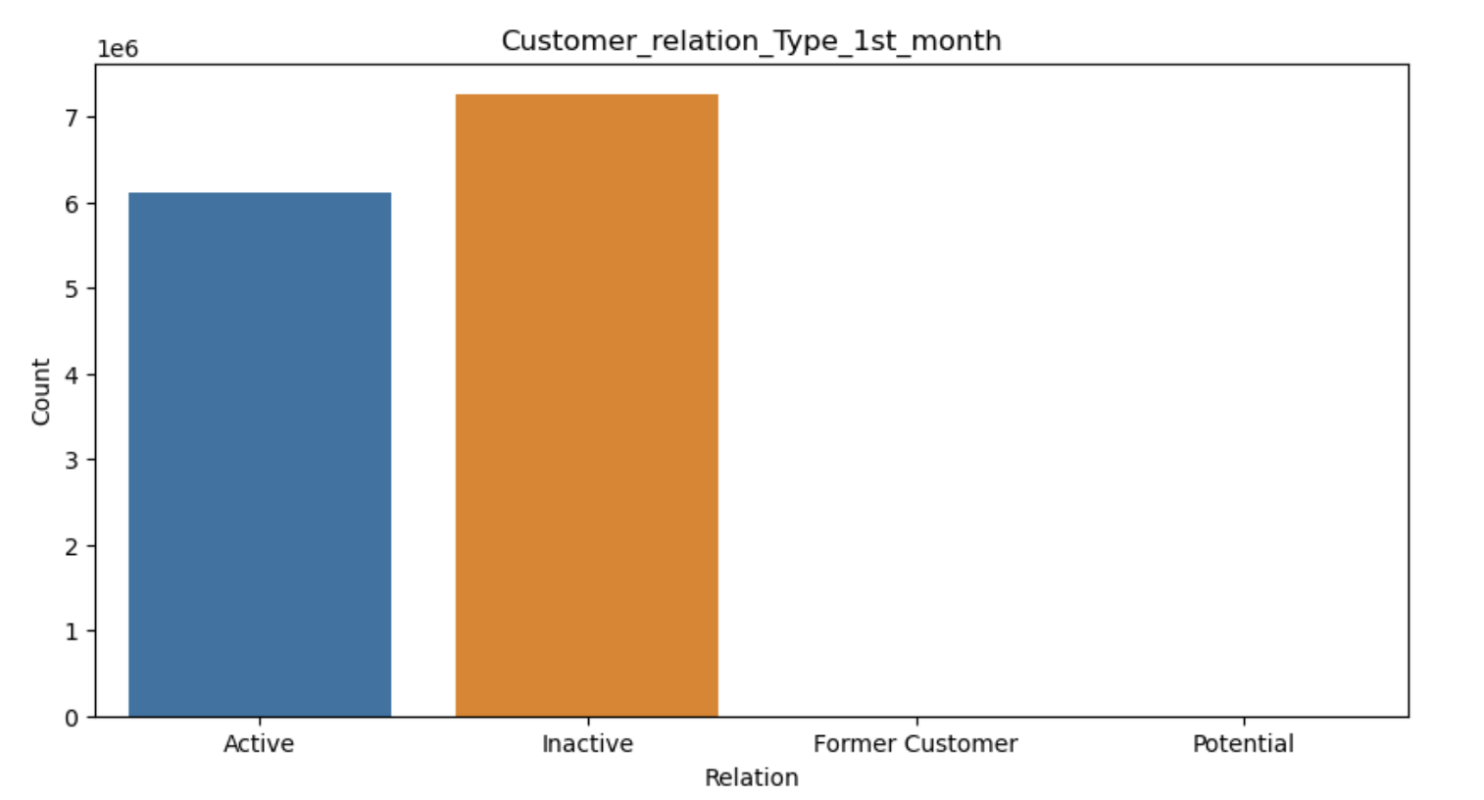
Customer Relation:
Active vs. Inactive: A significant portion of customers starts as inactive, indicating an opportunity to engage and activate these customers through targeted cross-selling efforts.

Slide 24
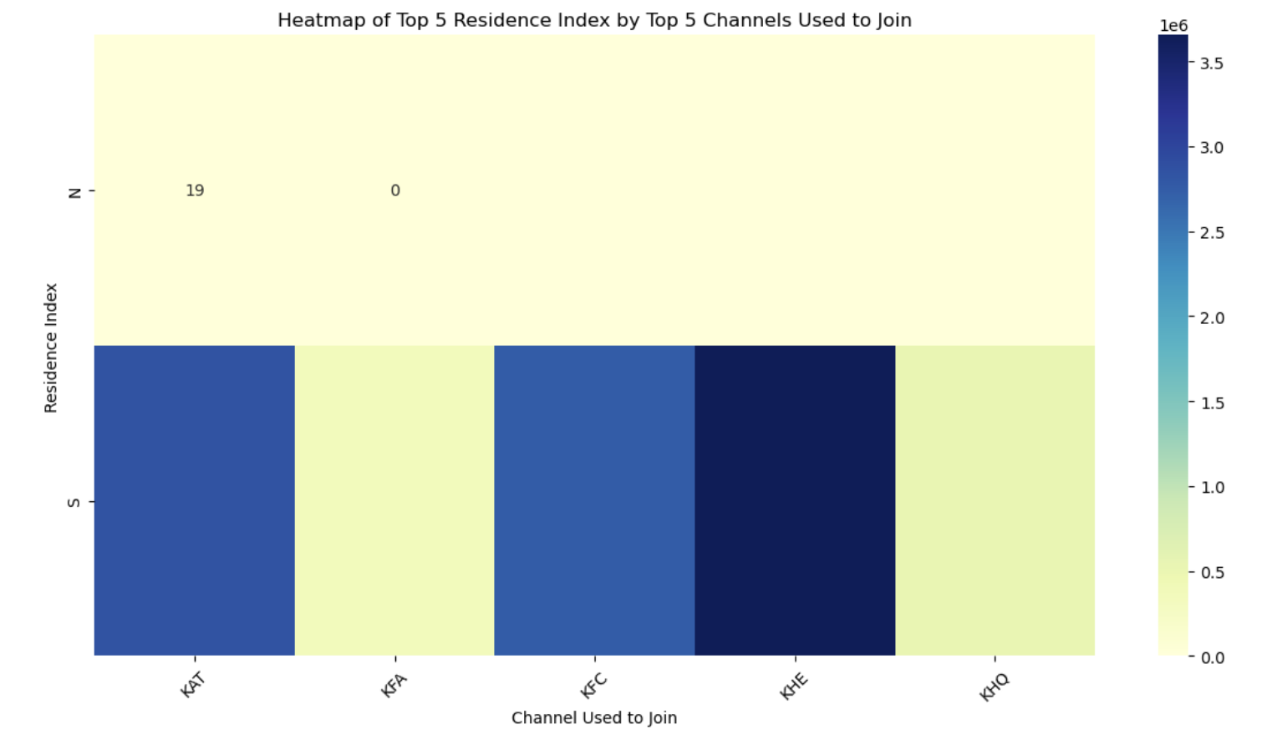
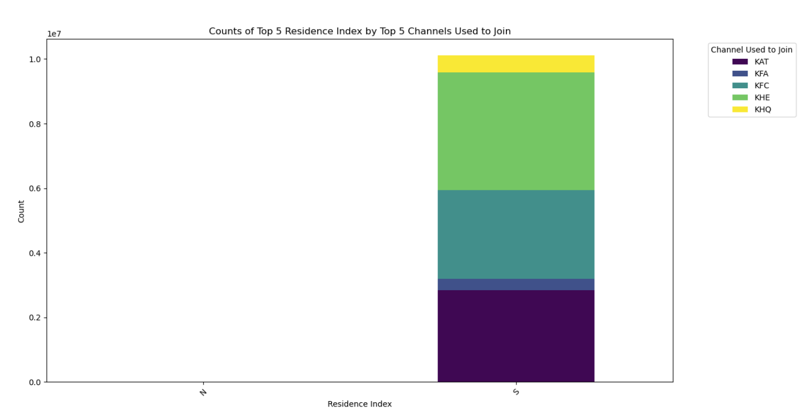
Heatmap of Mean Age by Segmentation and Top 5 Channels
This heatmap shows the mean age of customers in different segments and the top 5 channels used to join. The 'TOP' segment generally has older customers, while the 'UNIVERSITARIO' segment is younger. Channel-specific marketing efforts can be optimized based on these age trends.
Counts of Top 5 Residence Index by Top 5 Channels Used to Join
This bar chart shows the distribution of customers based on the residence index across the top 5 channels used to join. Channels like KAT and KHE have a significant number of customers with a high residence index, indicating strong regional engagement.

Slide 25
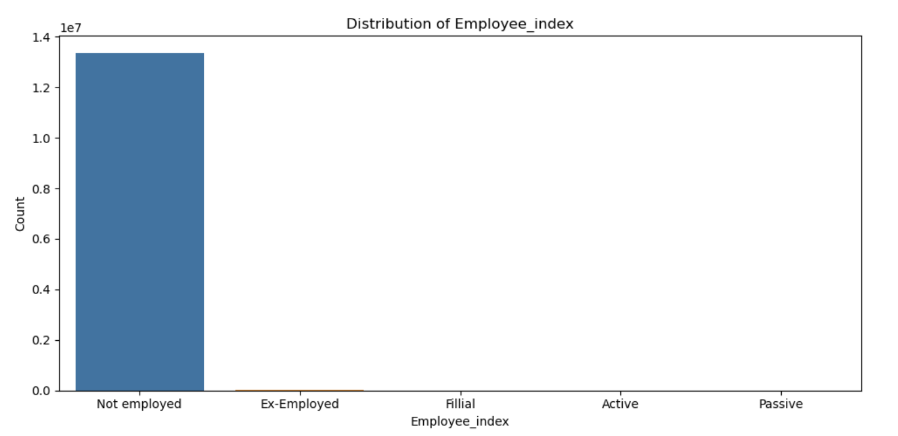
Employment Status:
Employee Index: Most of the customers are not employed, which might affect their purchasing power and product needs. Tailored product offerings can be developed to cater to their financial situations.

Slide 26
Recommendations

Slide 27
Focus on High-Potential Provinces:
Tailor marketing messages and product bundles specifically for regions with a high customer concentration, such as Madrid and Barcelona, to leverage the large customer base.
Utilize Customer Segmentation:
Create personalized offers for different segments, offering higher-value products to the 'Top' segment and educational savings plans or starter accounts to the 'Universitario' segment.
Optimize Effective Channels:
Develop channel-specific strategies for KHE, KAT, and KFC, which have the highest customer acquisition rates, to encourage additional product purchases through personalized follow-ups and targeted promotions.
Engage Younger Customers:
Offer products appealing to younger customers, such as mobile banking services, student loans, and first-time credit cards, especially through channels like KHQ.
Implement Data-Driven Campaigns:
Use insights from the correlation matrix and numerical features distribution to design personalized marketing campaigns, promoting products like retirement accounts to customers who show an affinity for long-term financial planning.
Enhance Customer Education:
Conduct financial literacy programs through workshops, webinars, and online tutorials to educate customers about the benefits of various banking products, making them more likely to invest in multiple products.

Slide 28
Automate and Personalize Communication:
Implement automated marketing tools to send timely and relevant product recommendations based on customer behavior and life events, such as suggesting mortgage products to customers who recently increased their savings balance.
Develop Bundled Product Offerings:
Create packages that combine multiple banking products with added benefits, like a package including a credit card, savings account, and insurance at a discounted rate, to appeal to a broader customer base.
Incentivize Through Loyalty Programs:
Establish loyalty programs that reward customers for purchasing multiple products with points, cashback, or discounts on future products, and encourage referrals through rewards.
Reactivate Inactive Customers:
Develop targeted campaigns to engage inactive customers with special incentives or personalized product recommendations to reactivate their accounts and encourage them to try additional products. Implement lifecycle marketing strategies to keep customers engaged at different stages of their relationship with the credit union.

Slide 29
Thank You

